Slide 1

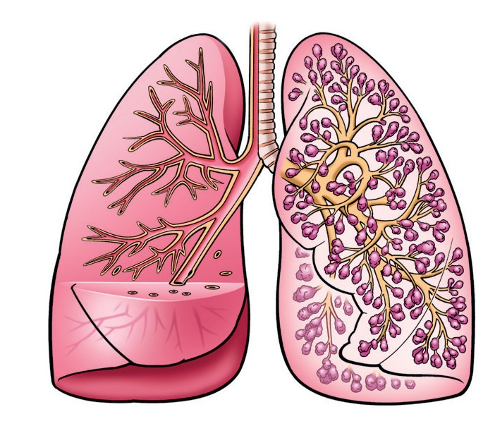
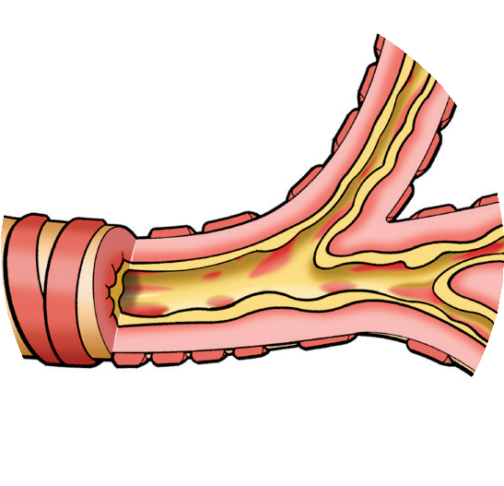

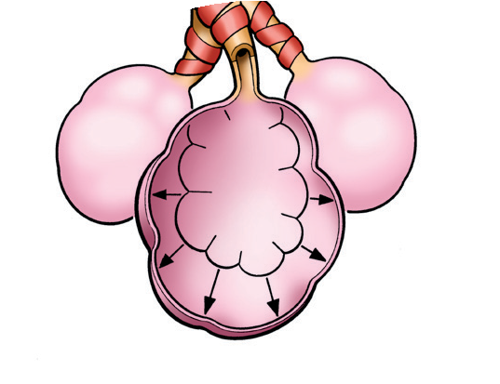



What are the symptoms of COPD?
COPD may cause one or more of these symptoms:
COPD—What Is It?
Why is it so hard to catch my breath?
“
“
Shortness of breath, especially with activity
Wheezing
Coughing up mucus
Coughing
Chest tightness
COPD is a disease of the lungs.
COPD can make it hard to breathe.
When you have COPD, it’s hard to get air through the airways and into and out of the air sacs.
Normal Lungs
Airways
Air Sacs
What causes COPD?
Smoking is the most common cause of COPD. Other risk factors include family history, exposure to dusts or chemicals in the workplace and home, and air pollution.
What is an exacerbation (ig-zas-er-BAY-shun)?
Your symptoms are worse than usual. Flare-up is another name for exacerbation. This can last for a few days or longer. You may need different medicines. You may need to go to the hospital.
COPD includes chronic bronchitis and emphysema.
r
h
o
C
n
i
—
c
B
y
r
a
o
w ^{n}c
_{A}ir h_{it}
i_{s}
1
Chronic bronchitis—
the walls of the airways become inflamed, swell, and clog with mucus. This partly or completely blocks the
airway, making it hard to move air in and out of the lungs.
Extra mucus
Taking care of COPD every day
The damage to your airways and lungs is permanent. But there are things you can do to help take care of your COPD.
Inflammation
If you smoke, quit.
E
—
m
c
p
a
h
S
y
r
s
Exercise regularly (ask your provider first what activities are best for you).
i
e
A
m
a
2
Emphysema—the walls of the tiny air sacs stretch out and break down inside. Your
lungs become overinflated and the air gets trapped, making it hard to take in the next breath.
Eat well and get enough rest.
Original air sac
Take your medicines as directed by your provider.
Broken air sac traps air inside, and air cannot get out
In general, avoid things that make your symptoms
worse. Protect yourself from airway infections.

Slide 2

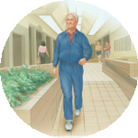

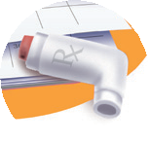



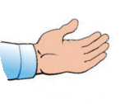
My COPD Goals
Attitudes and Beliefs
4
l
a
You are the most important person in managing your COPD. Talk with your provider to help you choose one or more goals you are ready to work on now.
Smoking
I will think of all the reasons why I should quit smoking.
I will ask my provider about how I can quit smoking and then take the steps to quit.
If I start smoking again, I will try to quit again.
Medicine
I will take my medicine(s) as directed by my provider.
I will ask questions when I do not understand my provider’s instructions.
I will learn how to use my inhaler, if prescribed, and have my provider check how I use it at every visit.
Provider Visits
I will keep my provider appointments, even when my breathing is stable.
I will ask my provider to test my lung function.
I will ask my provider about getting flu and pneumonia shots.
I will ask my provider questions when I do not understand something.
EMERGEnCY
I will get emergency help right away if:
a it’s hard to breathe, talk, or walk; b my lips or
o
G
1
Exercise and Healthy Lifestyle
I will learn breathing exercises.
I will walk or exercise for minutes days every week, as directed by my provider.
I will learn how to save energy by pacing myself.
I will take breaks after activity and get enough sleep.
I will eat a balanced diet and drink enough fluids. I will wash my hands and try to avoid people with colds or flu.
Air Pollutants
I will keep my home free of smoke, fumes, and strong smells.
I will stay away from smoky places.
I will stay inside as much as possible when the air quality outside is poor.
Help From Others
I will talk with family and friends about how having COPD makes me feel.
I will consider joining a COPD support group.
I will let my provider know if I feel moody, blue or stressed.
l
a
o
G
2
l
a
o
G
5
l
a
o
G
3
l
a
o
G
6
l
a
o
G
4 my symptoms suddenly get worse and don’t get
fingernails look blue; c my heartbeat is fast or irregular; or
better after taking my short-acting rescue medicine.

Slide 3
Treating COPD
There are a number of treatments that may help your breathing. Talk with your provider about what treatment is right for you. If you are still smoking, the most important thing you can do is quit.
Daily maintenance medicine
Most are inhaled medicines that you take every day to help manage your COPD.
It is important to use your daily maintenance medicine every day, even if you are feeling fine, unless directed by your provider to stop.
Some of these medicines may help prevent flare-ups.
Short-acting rescue medicine
Most are inhaled medicines you use when your breathing suddenly gets worse.
Your provider will tell you when and how to use a short-acting rescue medicine.
It is very important that you always carry your rescue inhaler with you for sudden symptoms of COPD.
Keep track of your symptoms and how your medicines help:
Watch for symptoms like more shortness of breath, increased mucus production, or more coughing than usual. Look for changes in the color of your mucus.
Tell your provider if new symptoms appear or if you have a flare-up.
Avoid exacerbations
Ask your provider how you can prevent a flare-up.
Ask your provider what to do if you have a flare-up.
Pulmonary rehabilitation
Provides education and support and helps with exercises and breathing techniques to help you manage your COPD.
Talk with your provider to see if you would benefit from this kind of program.
Oxygen
Patients with more severe COPD may benefit from oxygen therapy.
If your oxygen level is low, you may need extra oxygen to help you breathe better.
Exercising may help increase your strength to do
Your provider or respiratory healthcare professional can show you the right exercises and how to do them safely.
Ask your provider or dietitian to review your diet and help plan meals that are right for you.
everyday activities.
Follow your treatment plan exactly as directed by your healthcare provider.

Slide 4
My Medicines—Am I Taking Them As Directed?
Fill out a medicine chart like the one below and talk with your provider. This may help you take the right dose at the right time. Include all medicines that you take for
all reasons.
Always keep your short-acting rescue medicine with you. It can give you fast relief when your symptoms get worse.
You may think you can stop using your daily maintenance medicine once you feel better. This is the most likely reason why you feel better. Your airways still need it every day to treat COPD. Talk with your provider before you stop taking your medicine.
Name and Strength of Medicine
How Much I Take
When I Take It
What I Take It for
Dates to Refill Rx
Special Instructions

Slide 5
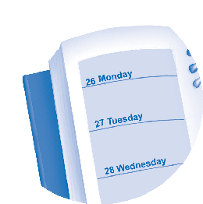
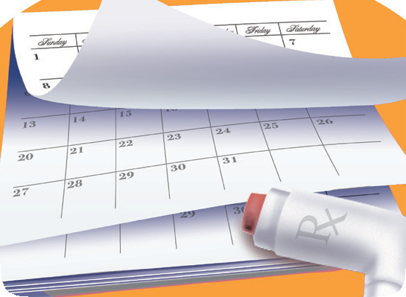
Sticking With My Medicine —
What Will Work?
Taking your COPD medicine as directed by your provider is one of the most important things you can do to help manage your COPD.
Not taking your daily maintenance medicine as directed by your provider means:
Your medicine may not work the way it should.
It may be harder to breathe.
You may have symptoms more often. The symptoms you have may be more severe.
Simple tasks may be harder for you to do.
Your lung function may get worse.
If you often forget to take your medicine:
Wear a watch. Set an alarm.
Leave yourself a note on the bathroom mirror.
Keep your daily maintenance medicine in a place where you will see it every day.
If you forget to refill your medicine on time:
Write “refill medicine” on your calendar about a week before your medicine will run out.
If your COPD medicine has one, use the dose-counter to help you keep track of the doses you have left.
Make sure you have enough refills to last until your next provider visit.
Ask your pharmacy to send you reminders
to refill your prescription.
The key is to create a routine that fits your life:
Try taking your daily maintenance medicine around the same time as other daily habits, such as in the morning when brushing your teeth or in the evening around dinnertime.
Ask your provider if there is a medicine you can take less often. A simpler medicine schedule may help you.
Work with your healthcare provider to find ways to take your COPD medicine every day as directed.

Slide 6
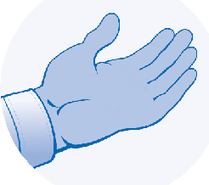
COPD Support—
For more help and information, contact one or more of these COPD resources:
Where Can I Go for Help?
“ I‘m having difficulty handling this all alone.
Ask a family member or friend for support, such as going with you to your next provider visit.
If you live with someone who smokes, ask them to quit. Ask for help keeping the air in your home clean.
Ask your provider about a COPD support group. You can find a group in your area at www.lung.org.
If you smoke, ask your provider about a program to help you quit.
If you have trouble paying for your medicines:
Visit www.togetherrxaccess.com, www.gskforyou.com, or www.PPARx.org for more information.
Another option is to call 800-MEDICARE (800-633-4227) or visit www.medicare.gov.
“
American Lung Association®
800-LUNGUSA (800-586-4872)
www.lung.org
national Heart, Lung, and Blood Institute
301-592-8573
www.nhlbi.nih.gov
American Association for Respiratory Care (AARC)
972-243-2272
www.aarc.org
Global Initiative for Chronic Obstructive Lung Disease®
www.goldcopd.org
The resources listed above are administered by independent third parties not affiliated with or endorsed by GlaxoSmithKline. GlaxoSmithKline is not responsible for the content of these resources.
Have you felt moody or blue?
It is common for people with chronic conditions, such as COPD, to feel moody or blue from time to time. If these feelings continue, you may lose interest in the things you used to like to do. Or you may have problems sleeping or working. The good news is that you don’t have to deal with these feelings by yourself. Talk with your family, friends, and provider for help.
To learn more about what may be getting in the way of taking your medicines, go to www.HealthCoach4Me.com.

