Slide 1

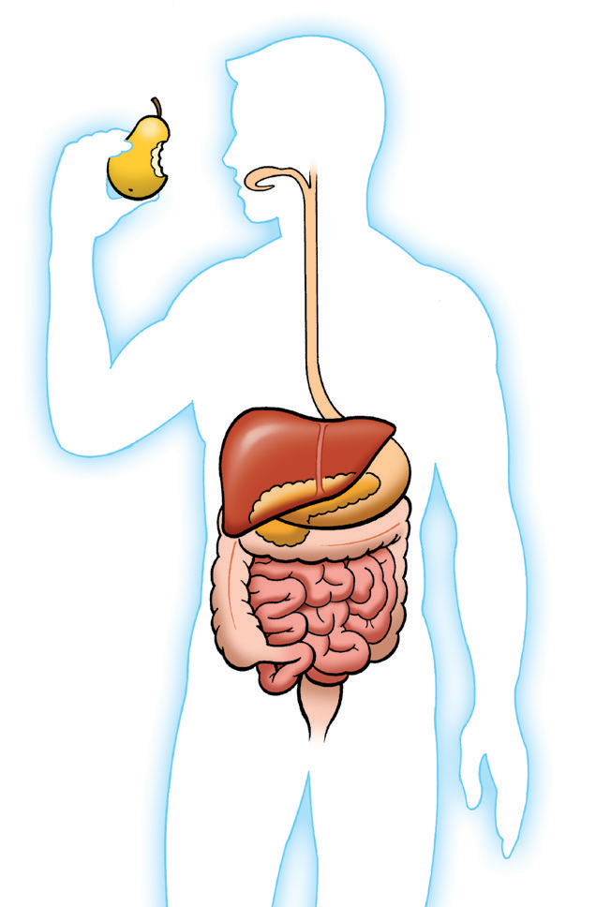
Type 2 Diabetes—What Is It?
“
“ Diabetes means that
Normal
I have diabetes. What does that mean?
As blood sugar rises after a meal, the pancreas releases insulin. Insulin helps sugar get into your body’s cells.
the sugar levels in your blood are too high. To understand diabetes,
Esophagus
Type 2 Diabetes
you must first know what happens when you eat.
What is glucose? Your body turns the food you eat into sugar,
also called glucose. Your blood carries this sugar to all the cells in your body. Your body uses the sugar for energy.
Type 2 diabetes occurs when your body does not make enough insulin, or your body does not respond well to its own insulin. Without enough insulin, your body does not get the energy it needs. Sugar builds up in the blood and can lead to serious health problems over the long term.
Liver
Stomach
Pancreas
Intestines
“
“ Currently there is no cure for diabetes. But there are ways to
Will I have diabetes for the rest of my life?
Digestive System
help manage it:
Eat right
Reach and stay at your goal weight
Keep blood sugar in a healthy range
Stay active
Take your medicine as directed
What is insulin?
Insulin is made by the pancreas. Insulin helps sugar get into your body’s cells where it can be used
for energy.
.
STILLWATER FAMILY CENTER

Slide 2
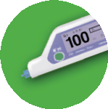









5
l
a
o
My Diabetes Goals— What Are They?
G
Blood Sugar Monitoring
I will check my blood sugar .
I will call my provider if the level is below or above .
I will .
You are the most important person in managing your diabetes. Talk with your provider to help you choose one or more goals you are ready to work on now.
Place a check next to your goals below.
Meal Plan and Weight Management
I will follow my diabetes meal plan, as directed by my provider.
I will reach and stay at my goal weight of . I will .
Exercise
I will get regular exercise: minutes, days per week, as directed by my provider.
My provider and I agree that the best activities
for me are .
I will .
Foot Care
I will check my feet every day for cuts, sores, and red spots.
I will call my provider right away if a sore on my foot does not start to heal after a few days.
I will have my provider check my feet at every visit. I will .
6
l
a
o
1
G
l
a
o
G
A1C (test of blood sugar control over time)
I will take steps to improve my A1C level to .
I will have my A1C measured twice a year—or more if I am not at my A1C goal.
I will .
Heart Health
I will ask my provider about taking aspirin for my heart. I will .
Eye Health
I will have a complete eye exam once per year. I will .
Smoking
I will think of all the reasons I should quit smoking.
I will ask my provider about how I can quit smoking and then take the steps to quit.
If I start smoking again, I will try to quit again. I will .
7
l
a
o
2
G
l
a
o
G
8
l
a
o
G
3
l
a
o
9
G
l
a
o
G
4
l
a
o
1
l
0
G
a
o
G
Medicine
I will take my diabetes medicine(s) as directed by my provider.
I will call my provider if I have problems.
I will .
Asking for Help
I will talk to my family about how diabetes makes me feel. I will join a diabetes support group.
I will let my provider know if I feel moody, blue, or stressed. I will .

Slide 3


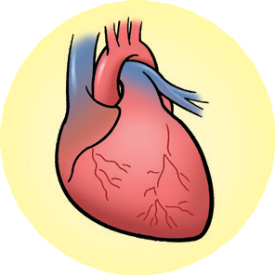
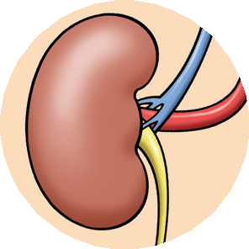

Managing Complications— What Else Can I Do?
C Foot Problems and Amputations
Check your feet every day for cuts, sores, red spots, and swelling. Call your provider right away if a sore on your foot does not start to heal after a few days.
Take off your shoes and socks at every provider visit and have your feet checked.
Diabetes can lead to nerve damage, which may cause you to lose feeling in your feet. As a result, a cut or sore can become infected before you even notice it.
D Kidney Problems
Your provider should check your kidney function once a year.
Call your provider if you have any
symptoms of kidney disease: fluid buildup, poor appetite, upset stomach, weakness, or trouble concentrating.
Your kidneys filter waste from your blood and then pass it into urine. Diabetes may overwork your kidneys. Over time the kidneys may stop filtering, and waste can build up in your blood. This is known as kidney failure.
STILLWATER FAMILY CENTER
Over time, high blood sugar can harm your body in many ways. You can help prevent these problems by managing your blood sugar and paying attention to your body. To see how well your treatment plan is working, your provider will check your A1C levels at least twice a year.*
You can help prevent long-term problems by taking these steps.
A Heart Attack and Stroke
Have your blood pressure checked at every provider visit.
Have your cholesterol checked once per year or as recommended by your provider.
Diabetes can harm your blood vessels. People with diabetes often have high blood pressure or “bad” cholesterol numbers. This increases your risk of heart disease and stroke.
B Eye Problems
Have a complete eye exam once a year.
Call your provider right away if you have any problems with your eyes: blurred
vision, eye redness or pain, double vision, seeing spots or floaters, loss of side vision, trouble reading, and feeling pressure in your eyes.
Over time high blood sugar may damage blood vessels in your eyes. This may block vision. Cataracts and glaucoma are also more common in people with diabetes.

Slide 4

My Healthcare Provider Visits—
Talking With My Healthcare Team
Check off the statements below that apply to you and take this list with you to each provider visit.
How Can I Get Ready?
You and your provider are a team in managing your diabetes. Talk openly and honestly with your provider.
Since my last visit:
I have missed taking some of my medicine(s).
I have stopped or changed how I take my medicine. I have checked my blood sugar as directed.
My blood sugar has been in my target range. I have checked my feet every day.
I have new symptoms or changes in my health. I have felt moody or blue some of the time.
I have made progress on my goals for managing diabetes.
All questions are important. Do not be afraid to speak up if you do not understand something
Do not be embarrassed to bring up more personal problems, like your sexual health. Your provider is used to talking about these problems.
If you have trouble understanding or remembering what your provider says:
Ask your provider to repeat anything you don’t understand.
Ask for written information about your medicine. Is it available in large print or another language?
Ask a family member to join you on provider visits. They can write down your provider’s answers.
STILLWATER FAMILY CENTER

Slide 5

Diabetes Support—
Help From Others
For more help and information, contact one or more of these diabetes resources:
American Diabetes Association (ADA)
800-DIABETES (800-342-2383)
www.diabetes.org
National Diabetes Information Clearinghouse (NDIC)
800-860-8747
www.diabetes.niddk.nih.gov
National Diabetes Education Program
301-496-3583
www.ndep.nih.gov/index.aspx
The resources listed above are administered by independent third parties not affiliated with or endorsed by GlaxoSmithKline. GlaxoSmithKline is not responsible for the content of these resources.
Where Can I Go for Help?
I need help. I can’t do this on my own.
Ask a family member or friend to support you, such as going with you to your next provider visit.
Ask your provider about a support group for people with diabetes. You can find a group in your area at www.diabetes.org.
“
“
If you have trouble paying for your medicine:
If you have Medicare or think you are eligible for Medicare, call 800-MEDICARE (800-633-4227),
or visit www.medicare.gov.
For more information on Medicaid, contact your state Medicaid agency.
To learn more about what may be getting in the way of taking your medicine, go to www.HealthCoach4Me.com.
Have you felt moody or blue?
It’s common for people with chronic conditions, such as diabetes, to feel moody or blue from time to time. If these feelings continue, you may lose interest in the things you used to like to do. Or you may have
problems sleeping and working. The good news is that you don’t have to deal with these feelings by yourself. Talk to your family, friends, and provider for help.

